Slide 1
Unit II - REGRESSION ANALYSIS AND FORECASTING

Slide 2
Unit outcome
2. Illustrate the regression analysis and forecasting in time series analysis

Slide 3
Statistical Inference in Linear Regression
In this section, we describe several important hypothesis-testing procedures and a confidence interval estimation procedure.
These procedures require that the errors 𝜀i in the model are normally and independently distributed with mean zero and variance 𝜎2, abbreviated NID(0, 𝜎2).
What is the significance test for linear regression?
Significance tests for linear regression are used to determine if the relationship between the dependent variable and one or more independent variables is statistically significant.

Slide 4
Test for Significance of Regression
The test for significance of regression is a test to determine whether there is a linear relationship between the response variable y and a subset of the predictor or regressor variables x1, x2,…, xk.
The appropriate hypotheses are
H0 : 𝛽1 = 𝛽2 = ⋯ = 𝛽k = 0
H1 : at least one 𝛽j ≠ 0 Eq.
Rejection of the null hypothesis H0 in Eq. implies that at least one of the predictor variables x1, x2,…, xk contributes significantly to the model

Slide 5
Introduction to Hypothesis Testing
A statistician will make a decision about whether these claims are true or false. This process is called hypothesis testing.
A hypothesis test involves collecting data from a sample and evaluating the data.
Notes:
https://ecampusontario.pressbooks.pub/introstats/chapter/8-1-introduction-to-hypothesis-testing/

Slide 6
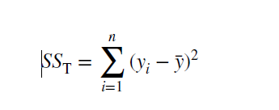
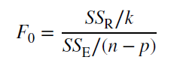
The test procedure involves an analysis of variance partitioning of the total sum of squares
into a sum of squares due to the model (or to regression) and a sum of squares due to residual (or error), say,
SST = SSR + SSE
Now if the null hypothesis in Eq.( H1 : at least one 𝛽j ≠ 0 ) is true and the model errors are normally and independently distributed with constant variance as assumed, then the test statistic for significance of regression is

Slide 7
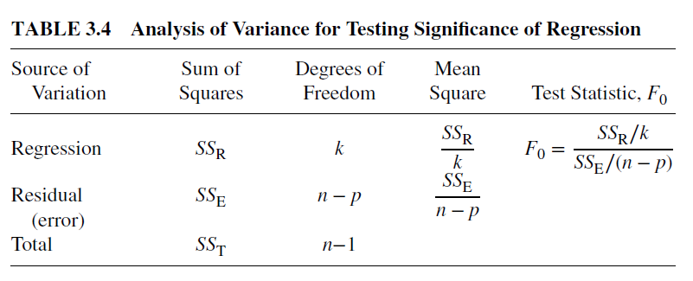
Calculate the Sum of Squares Total (SST): SST represents the total variation in the dependent variable. It's calculated as the sum of the squared differences between each data point and the mean of the dependent variable.
Calculate the Sum of Squares Regression (SSR): SSR represents the variation in the dependent variable that your model explains. It's calculated as the sum of the squared differences between the predicted values from your model and the mean of the dependent variable.
Calculate the Residual Sum of Squares (SSE): SSE represents the unexplained variation or error in your model. It's calculated as the sum of the squared differences between the actual data points and the predicted values from your model.
Compute R-squared (R²): R-squared is calculated as the ratio of SSR to SST. In other words, it tells you what proportion of the total variation in the dependent variable is explained by your model. The formula for R-squared is: R² = 1 - (SSE / SST)
Degrees of Freedom Where n is the sample size:
Notes:
https://www.kaggle.com/code/nargisbegum82/step-by-step-ml-linear-regression

Slide 8
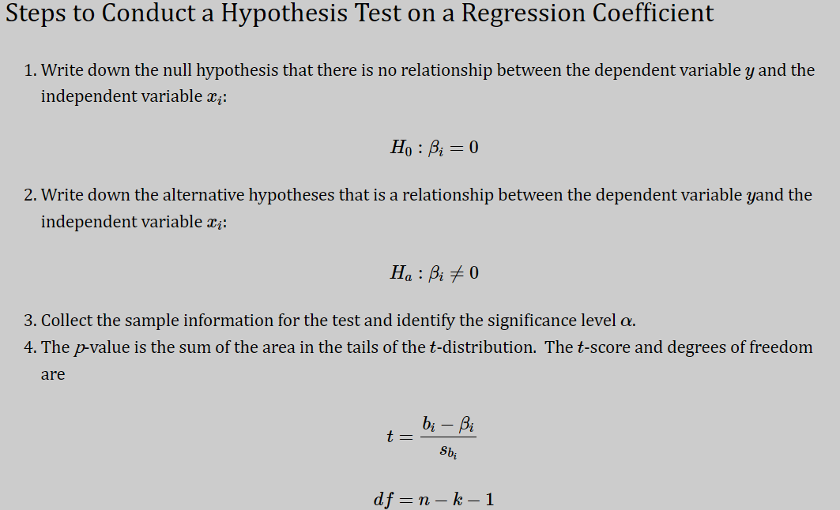
Tests on Individual Regression Coefficients We are frequently interested in testing hypotheses on the individual regression coefficients.
These tests would be useful in determining the value or contribution of each predictor variable in the regression model.

Slide 9
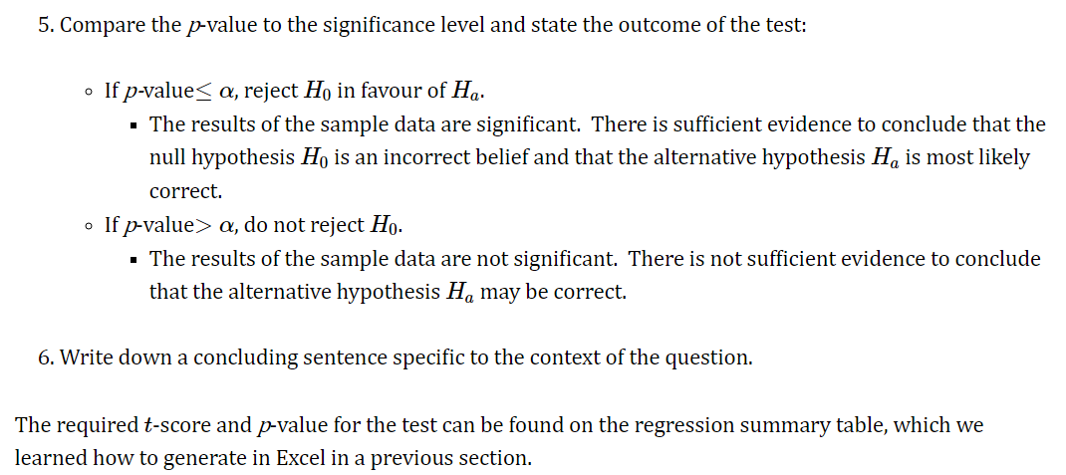

Slide 10
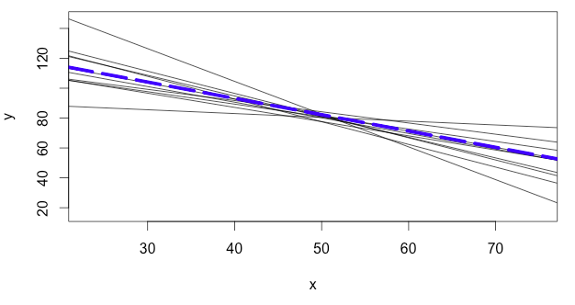
The image below shows these least square regression lines generated from different random samples as solid grey lines, and
the true population regression line as a dotted blue line.

Slide 11
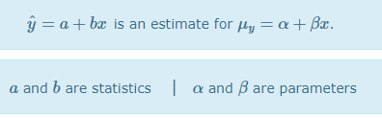
The least squares regression line (yˆ=a+bx), which runs through a sample of data points, is really an estimate of the true population regression line (μy=α+βx).

Slide 12
We conduct statistical inference in linear regression when we find a sample slope and
then use it to make a confidence interval or perform a hypothesis test about the true population slope.
Notes:
https://www.stats4stem.org/inference-linear-regression

Slide 13
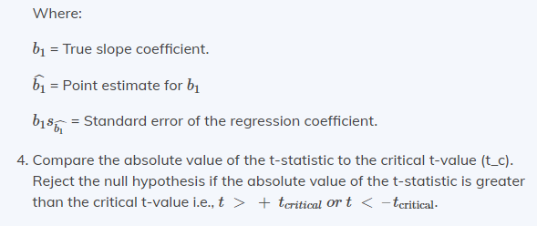

Hypothesis testing approach
The t-test Approach
The following are the steps followed in the performance of the t-test:
Set the significance level for the test.
Formulate the null and the alternative hypotheses.
Calculate the t-statistic using the formula below
Notes:
https://ecampusontario.pressbooks.pub/introstats/chapter/13-6-testing-the-regression-coefficients/
https://analystprep.com/cfa-level-1-exam/quantitative-methods/hypothesis-testing-in-regression-analysis/

Slide 14
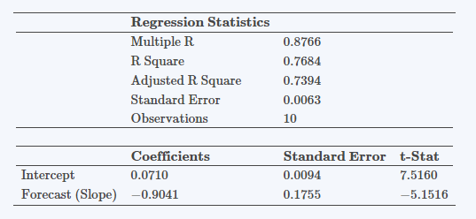
Example: Hypothesis Testing of the Significance of Regression Coefficients

Slide 15
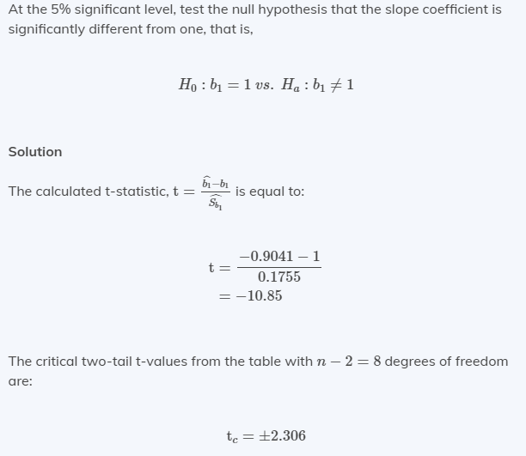
Notice that |t| > tc|t| > tc i.e., (10.85>2.30610.85>2.306)
Therefore, we reject the null hypothesis and conclude that the estimated slope coefficient is statistically different from one.

Slide 16
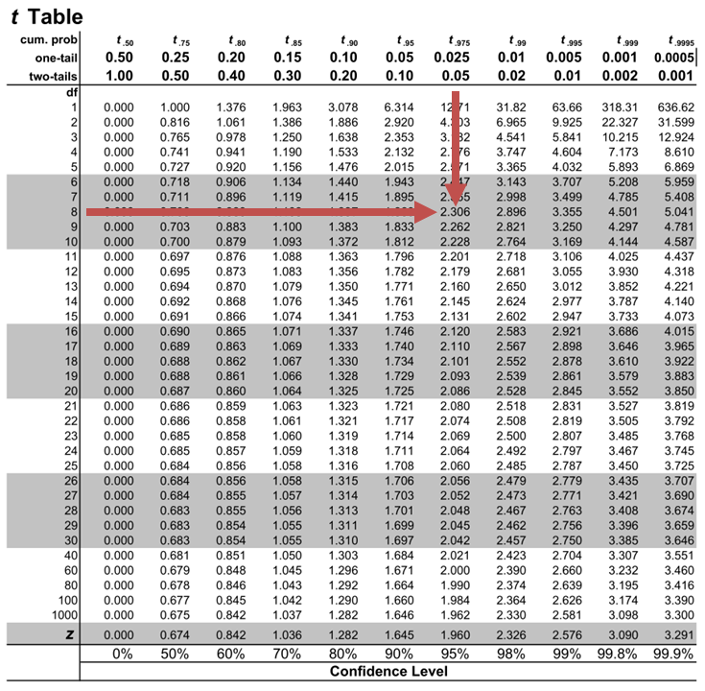

Slide 17
Tests on Groups of Coefficients
The procedure for doing this is the general regression significance test or, as it is more often called, the extra sum of squares method.
This procedure can also be used to investigate the contribution of a subset involving several regressor or predictor variables to the model.
y= X𝜷 + 𝜺, eq.
where y is (n × 1),
X is (n × p),
𝜷 is ( p × 1),
𝜺 is (n × 1), and p = k + 1.
We would like to determine if a subset of the predictor variables x1, x2, … , xr

Slide 18
Regression: Creating models to predict future observations
The Regression Approach for Predictions
Using regression to make predictions doesn’t necessarily involve predicting the future. Instead, you predict the mean of the dependent variable given specific values of the independent variable(s).

Slide 19
The general procedure for using regression to make good predictions is the following:
Research the subject-area so you can build on the work of others. This research helps with the subsequent steps.
Collect data for the relevant variables.
Specify and assess your regression model.
If you have a model that adequately fits the data, use it to make predictions.
Notes:
https://www.dataquest.io/blog/statistical-learning-for-predictive-modeling-r/

Slide 20
In R programming, predictive models are extremely useful for forecasting future outcomes and estimating metrics that are impractical to measure.
Notes:
https://www.dataquest.io/blog/statistical-learning-for-predictive-modeling-r/

Slide 21
Steps for prediction
Collect some data relevant to the problem (more is almost always better).
Clean, augment, and preprocess the data into a convenient form, if needed.
Conduct an exploratory analysis of the data to get a better sense of it.
Using what you find as a guide, construct a model of some aspect of the data.
Use the model to answer the question you started with, and validate your results.

Slide 22
Example
Linear regression is one of the simplest and most common supervised machine learning algorithms that data scientists use for predictive modeling
Example: regression to build a model that predicts cherry tree volume from metrics that are much easier for folks who study trees to measure.

Slide 23
Example continue
If you want to practice building the models and visualizations yourself, we’ll be using the following R packages:
data sets This package contains a wide variety of practice data sets. We’ll be using one of them, “trees”, to learn about building linear regression models.
ggplot2 We’ll use this popular data visualization package to build plots of our models.
GGally This package extends the functionality of ggplot2. We’ll be using it to create a plot matrix as part of our initial exploratory data visualization.
scatterplot3d We’ll use this package for visualizing more complex linear regression models with multiple predictors.

Slide 24
Example continue
How do they measure tree volume, anyway?
data(trees) ## access the data from R’s datasets package
head(trees) ## look at the first several rows of the data
str(trees) ## look at the structure of the variables
Girth | Height | Volume
8.3 | 70 | 10.3
8.6 | 65 | 10.3
8.8 | 63 | 10.2
10.5 | 72 | 16.4
10.7 | 81 | 18.8
10.8 | 83 | 19.7

Slide 25
Example continue
$ Girth : num | 8.3 8.6 8.8 10.5 10.7 10.8 11 11 11.1 11.2 …
$ Height: num | 70 65 63 72 81 83 66 75 80 75 …
$ Volume: num | 10.3 10.3 10.2 16.4 18.8 19.7 15.6 18.2 22.6 19.9 …
The trunk girth (in)
height (ft)
volume (ft³)
To decide whether we can make a predictive model, the first step is to see if there appears to be a relationship between our predictor and response variables (in this case girth, height, and volume).
ggpairs(data=trees, columns=1:3, title="trees data")
Let’s do some exploratory data visualization. We’ll use the ggpairs() function from the GGally package to create a plot matrix to see how the variables relate to one another.

Slide 26
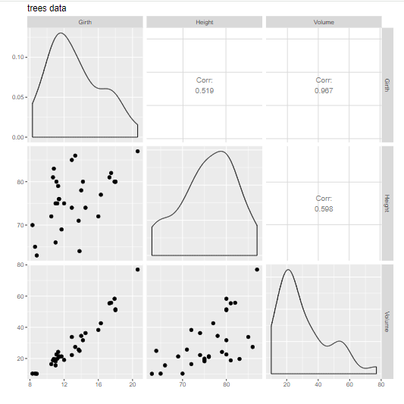
Example continue
The ggpairs() function gives us scatter plots for each variable combination, as well as density plots for each variable and the strength of correlations between variables.

Slide 27
Example continue
Forming a hypothesis and use
A hypothesis is an educated guess about what we think is going on with our data.
In this case, let’s hypothesize that cherry tree girth and volume are related.
Every hypothesis we form has an opposite: the “null hypothesis” (H0). Here, our null hypothesis is that girth and volume aren’t related.
In statistics, the null hypothesis is the one we use our data to support or reject; we can’t ever say that we “prove” a hypothesis.
We call the hypothesis that girth and volume are related our “alternative” hypothesis (Ha).
To summarize: H0 : There is no relationship between girth and volume
Ha: There is some relationship between girth and volume Our linear regression model is what we will use to test our hypothesis.
If we find strong enough evidence to reject H0, we can then use the model to predict cherry tree volume from girth.

Slide 28
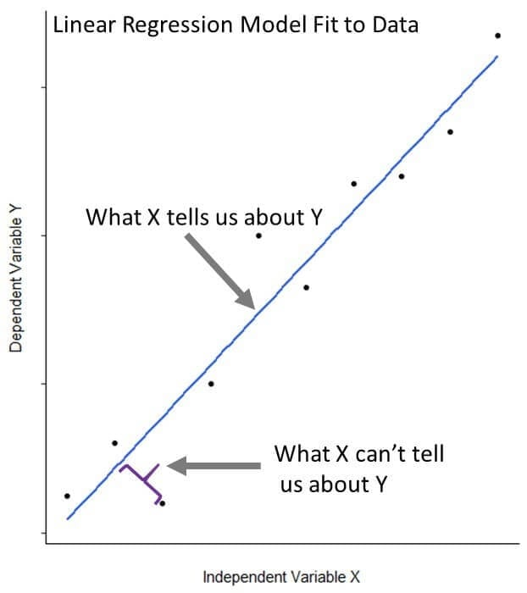
Example continue
Building blocks of a linear regression model
Let’s dive right in and build a linear model relating tree volume to girth. R makes this straight forward with the base function lm().
fit_1 <- lm(Volume ~ Girth, data = trees)
The lm() function fits a line to our data that is as close as possible to all 31 of our observations.

Slide 29
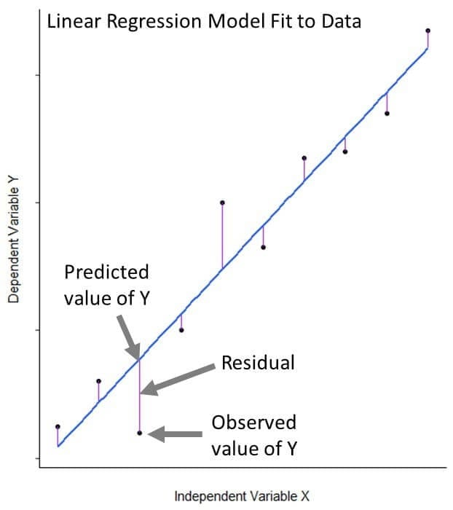
Example continue
Mathematically, can we write the equation for linear regression as: Y ≈ β0 + β1X + ε
The Y and X variables are the response and predictor variables from our data that we are relating to eachother
β0 is the model coefficient that represents the model intercept, or where it crosses the y axis
β1 is the model coefficient that represents the model slope, the number that gives information about the steepness of the line and its direction (positive or negative)
ε is the error term that encompasses variability we cannot capture in the model (what X cannot tell us about Y)

Slide 30
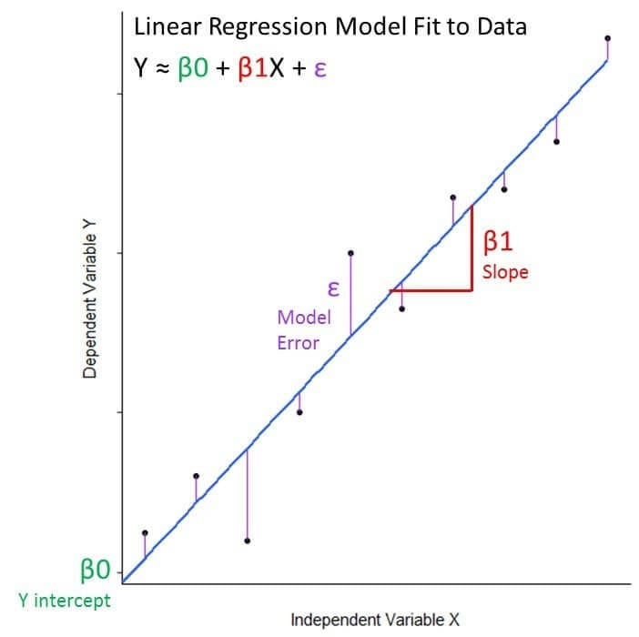
In the case of our example: Tree Volume ≈ Intercept + Slope(Tree Girth) + Error

Slide 31
Can we use this model to make predictions?
Whether we can use our model to make predictions will depend on:
Whether we can reject the null hypothesis that there is no relationship between our variables.
Whether the model is a good fit for our data.
Let’s call the output of our model using summary().
summary(fit_1)

Slide 32
Is the hypothesis supported?
Coefficients: Estimate and Std. Error:
The intercept in our example is the expected tree volume if the value of girth was zero. Of course we cannot have a tree with negative volume, but more on that later.
The slope in our example is the effect of tree girth on tree volume. We see that for each additional inch of girth, the tree volume increases by 5.0659 ft^{3.}
The coefficient standard errors tell us the average variation of the estimated coefficients from the actual average of our response variable.

Slide 33
t value:
This is a p-value, defined as the probability of observing any value equal or larger than t if H₀ is true. The larger the t statistic, the smaller the p-value. Generally, we use 0.05 as the cutoff for significance; when p-values are smaller than 0.05, we reject H₀.
We can reject the null hypothesis in favor of believing there to be a relationship between tree width and volume.

Slide 34
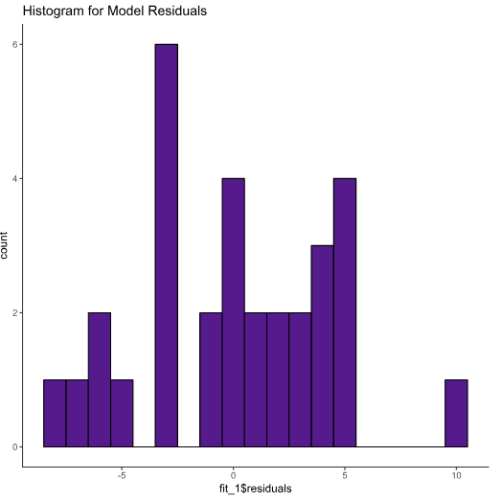
How well does the model fit the data?
Residuals:
We can make a histogram to visualize this using ggplot2.
ggplot(data=trees, aes(fit_1$residuals)) +
geom_histogram(binwidth = 1, color = "black", fill = "purple4") +
theme(panel.background = element_rect(fill = "white"),
axis.line.x=element_line(),
axis.line.y=element_line()) +
ggtitle("Histogram for Model Residuals")

Slide 35
Using our simple linear model to make predictions
predict(fit_1, data.frame(Girth = 18.2))
Adding more predictors: multiple linear regression
Girth | Height | Volume
18.2 in | 72 ft | 46.2 ft³
Notes:
https://www.dataquest.io/blog/statistical-learning-for-predictive-modeling-r/

